Slide 1

‘Eniac’
Let’s think bigger!
Data Analysts Team:
Mansi, Jyoti, Mohamed, Michael, Anna

Slide 2


Discounts!!!
Great for customers
But
What about the
Company ???
yes
Let's dive into the analysis to uncover if discounts are a smart strategy or a risky gamble."

Slide 3
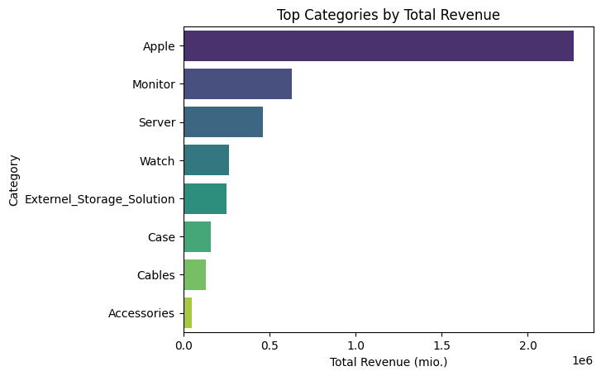
Categorial Revenue Distribution
95 % of all items were reduced
in the underlying 15-month period.
The average discount was
21 %.
The revenue for the top categories is 4,2 mil.

Slide 4
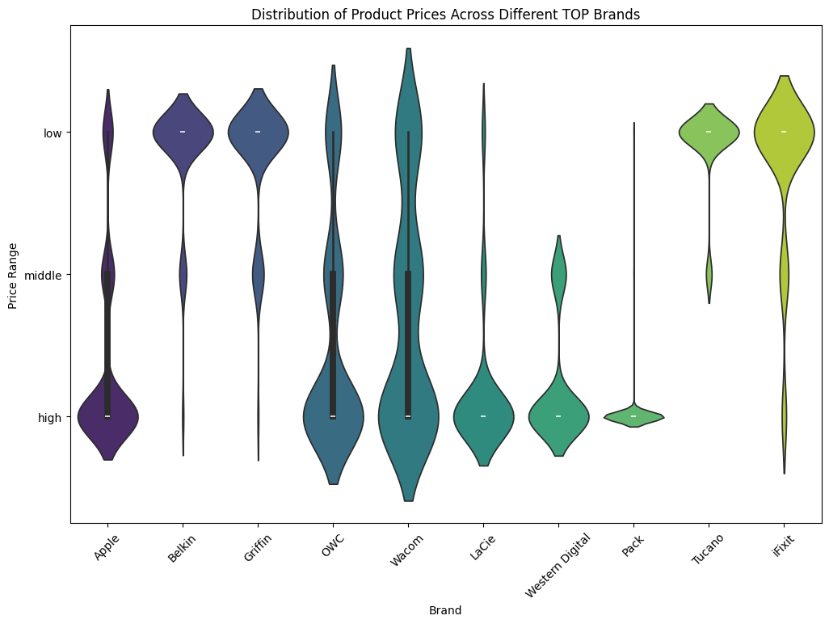
Categorial Price Distribution
counts
Counts
Price Range:
Low: 0-49.99
Middle:50-670
High: > 670

Slide 5
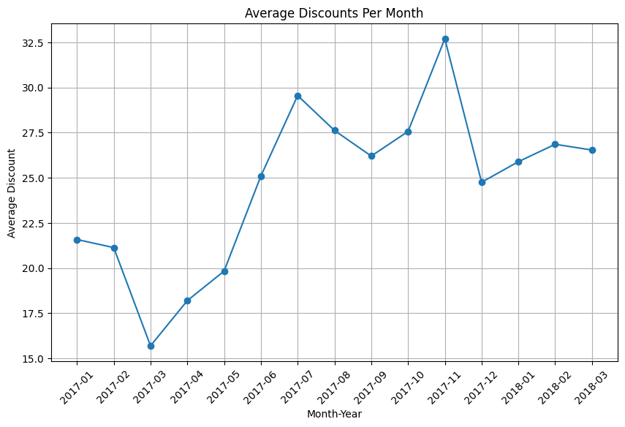
Discounts Average
Significant discounts during peak sales
Lower discounts in slower months

Slide 6
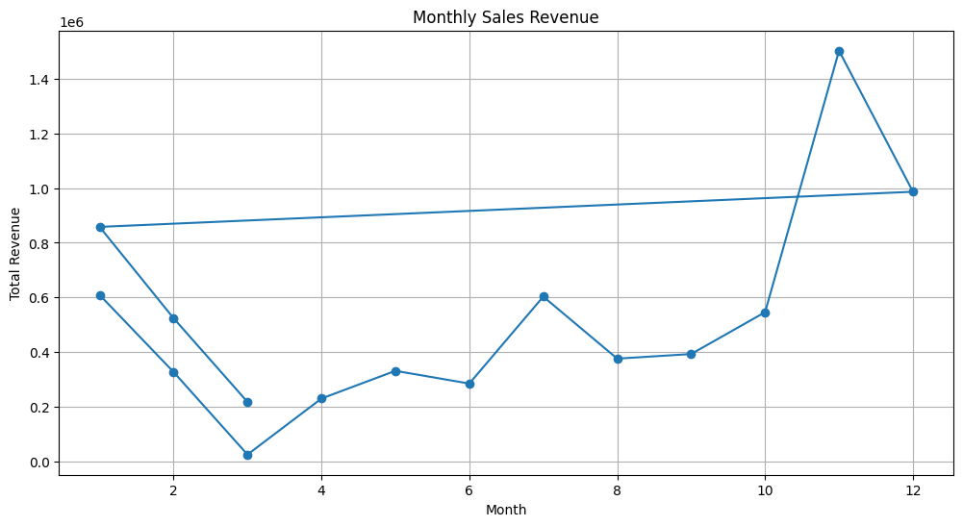
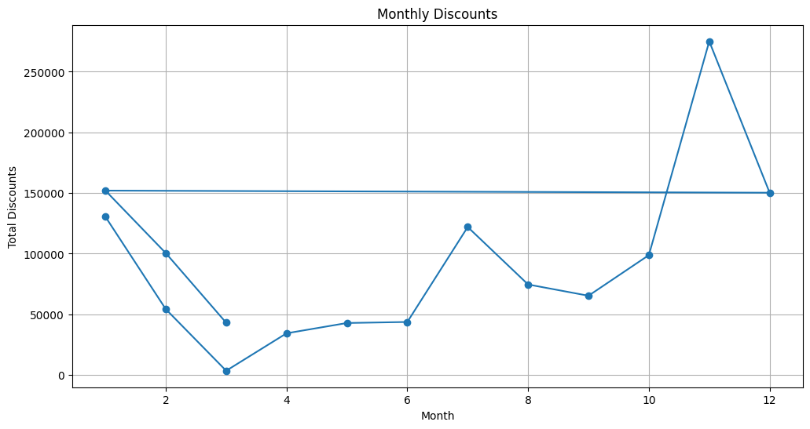
Revenue and Discount Trends
Sales Revenue
Monthly Discounts

Slide 7




Increased Sales Volume
Customer loyalty
Inventory Clearance
Competitive Edge
Discounts – Powerful Incentive to Drive Purchases

Slide 8
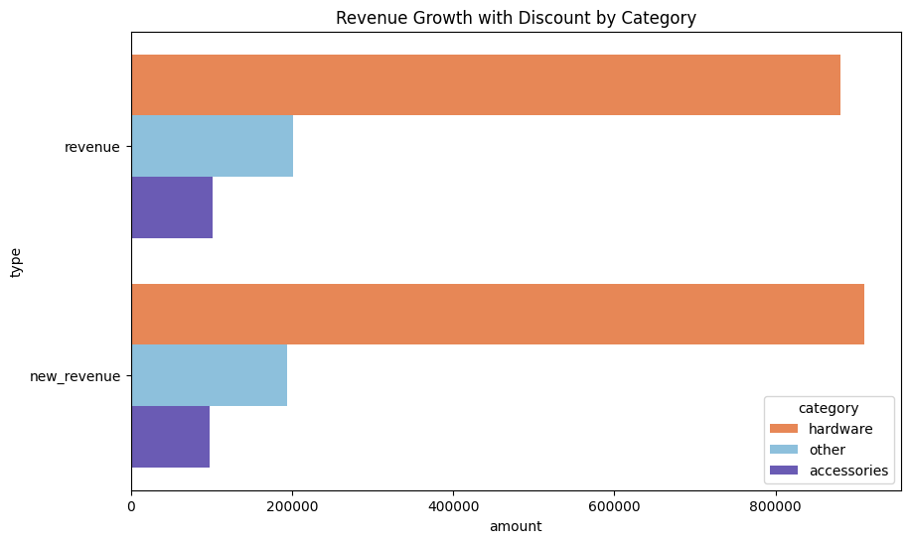
Conclusion
“Category-Based Discount Strategy”
Revenue Growth of Nearly €18,000
Total = €1,183,601
3% less discount on Hardware
3% more discount on
accessories & others
Total = €1,201,157
the revenue for Apple products and their related items in Q4,
along with the revenue after adjusting the discounts.

Slide 9

Limitation & Improvements
Unaware of the Company Goals
(Need more sales/profit/brand awareness)
Missing Information
(Customer information/Profits/Margins/Discount Strategies)
Data Collection Improvements
(Prices/Duplicates/Format)

Slide 10
Thank You

